Slide 1

Download & Installing Android Studio
BSIT - 2A

Slide 2
Now were going to show you how to do the step by step downloading and installing Android Studio.
First of all we need to do is download the Android Studio Installer.
Open any Search Engine. Example are Google Chrome, Mozilla Firefox, and Explorer etc.
Search the Website. Link (https://developer.android.com/studio).
For other version search this link (https://developer.android.com/studio/archive?fbclid=IwAR1zgwhg3yOB0dlofrG8pRce2P0F_MF1kypTXI-ECIOEY8H6SU1rVTMoYrA).

Slide 3
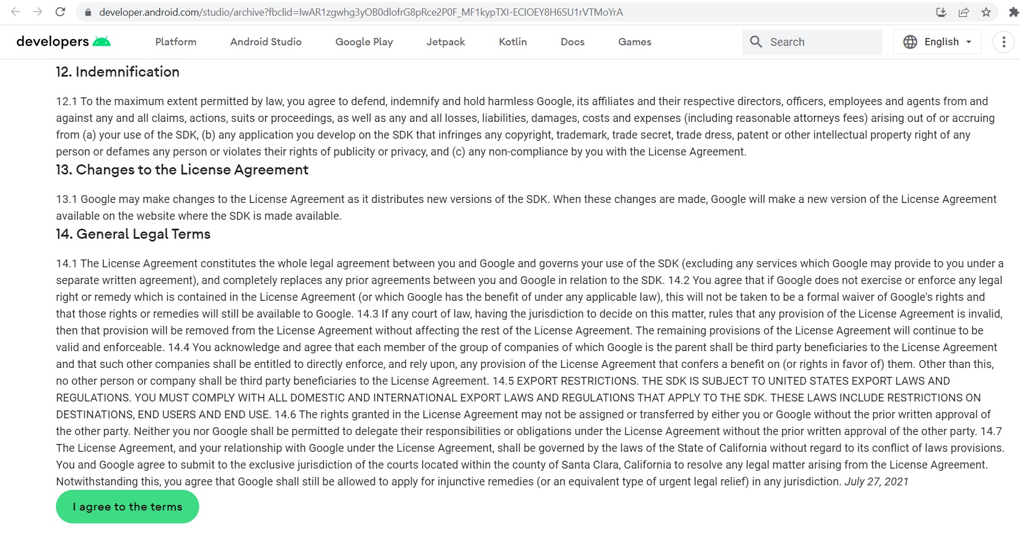
For other Version this is the procedure.
Click the I agree the term to proceed.

Slide 4
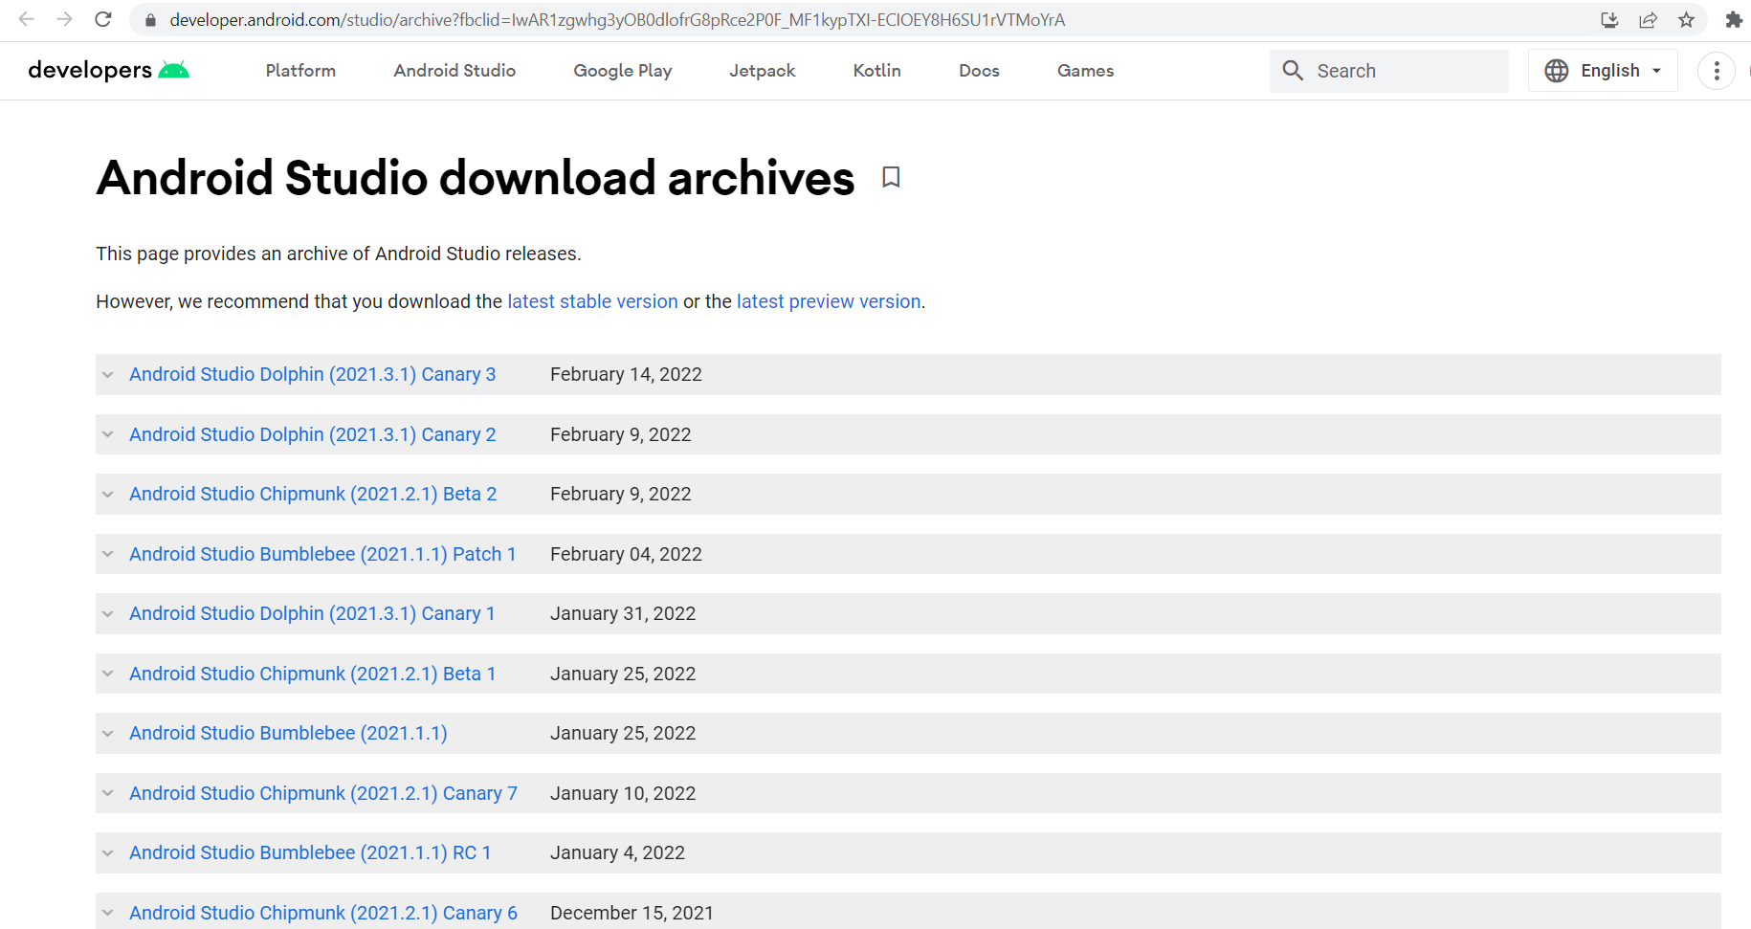
You can find Variants of Version of Android Studio to download and install.

Slide 5
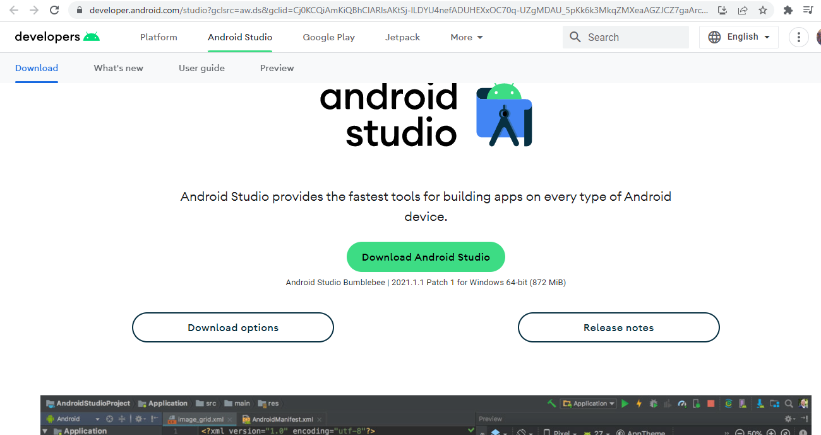
To download the latest Version of Android Studio. Click the “Download Android Studio”.
Click Here.

Slide 6
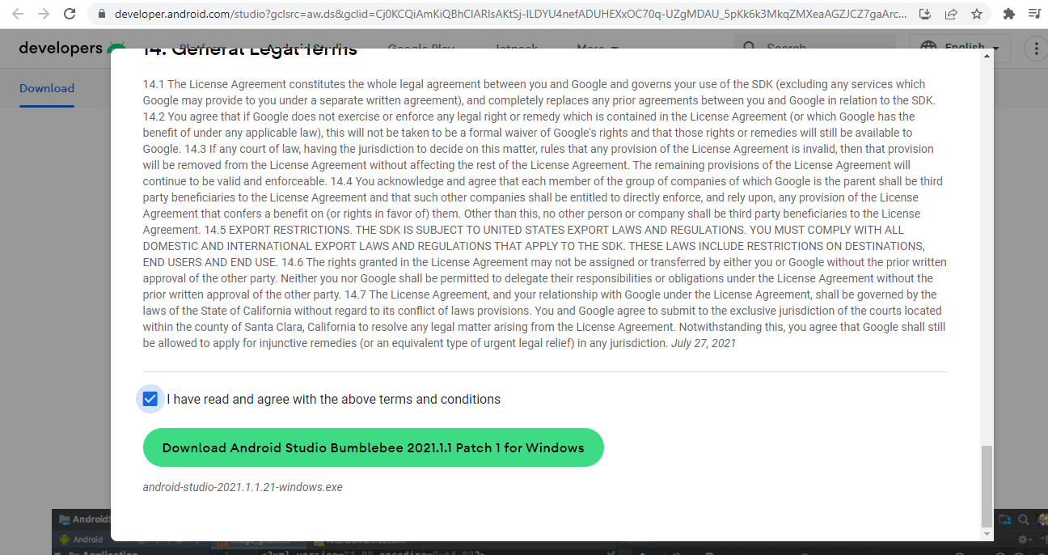
Then look at the "terms and conditions." After reviewing the terms and conditions check the box, then download the Android Studio program.

Slide 7
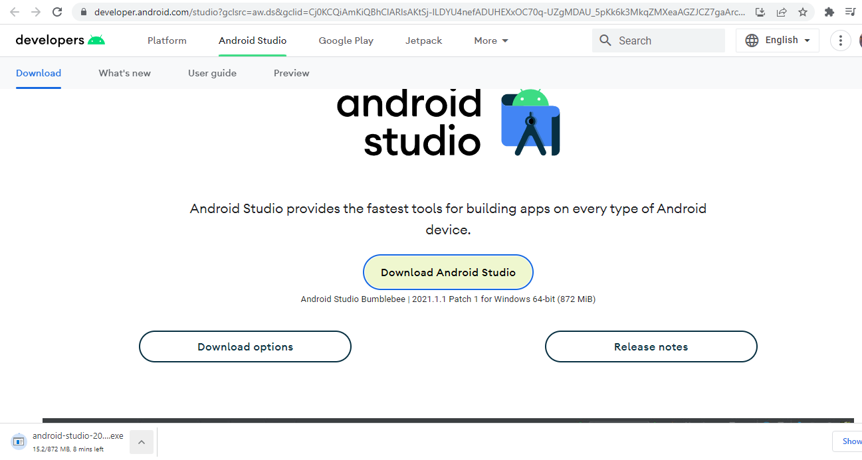
This will appear on the right bottom of your screen once you click the Download Android Studio button.

Slide 8
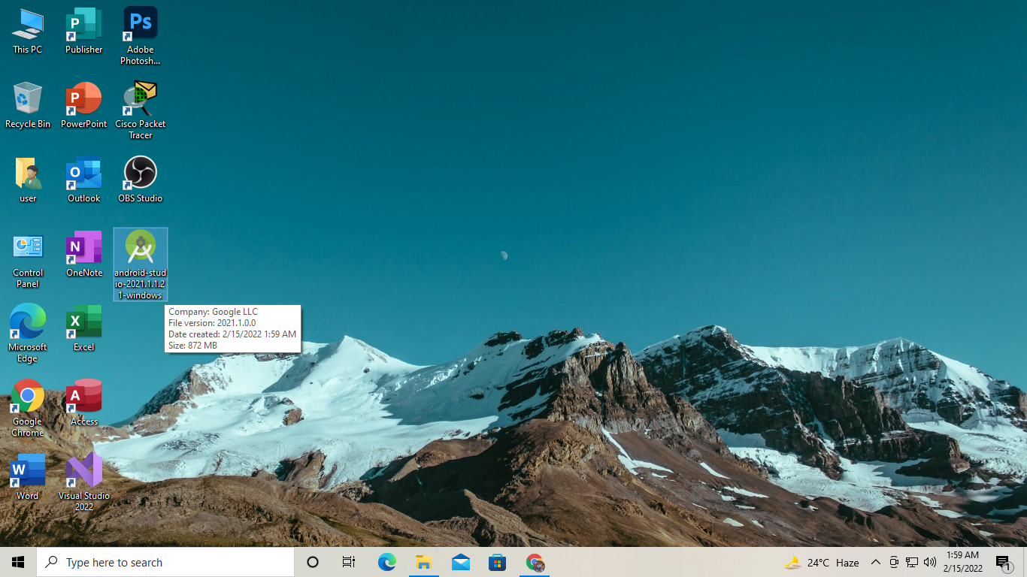
When you're done downloading. Your computer will display the Android Studio icon in the location you selected for your download.

Slide 9
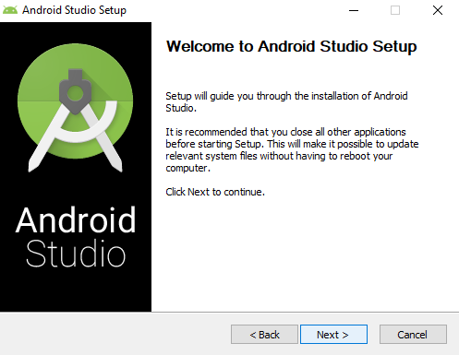
Read the Guide and Click Next

Slide 10
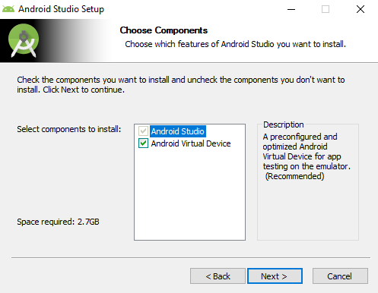
It will ask you if you want to check or uncheck the android virtual device. if you uncheck, it will reduce space and remove extra system requirements. However, if you wish to test your program on a device but uncheck the other optional system, it will not function; instead, you may test it on an emulator.
Click next to proceed.

Slide 11
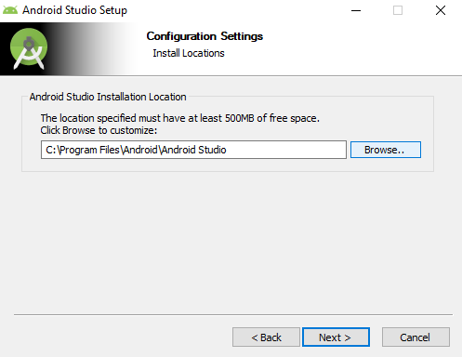
This is the location where you may save the application file.
Click next to proceed.

Slide 12
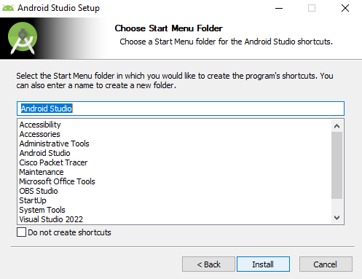
This button will install the application on your device.

Slide 13
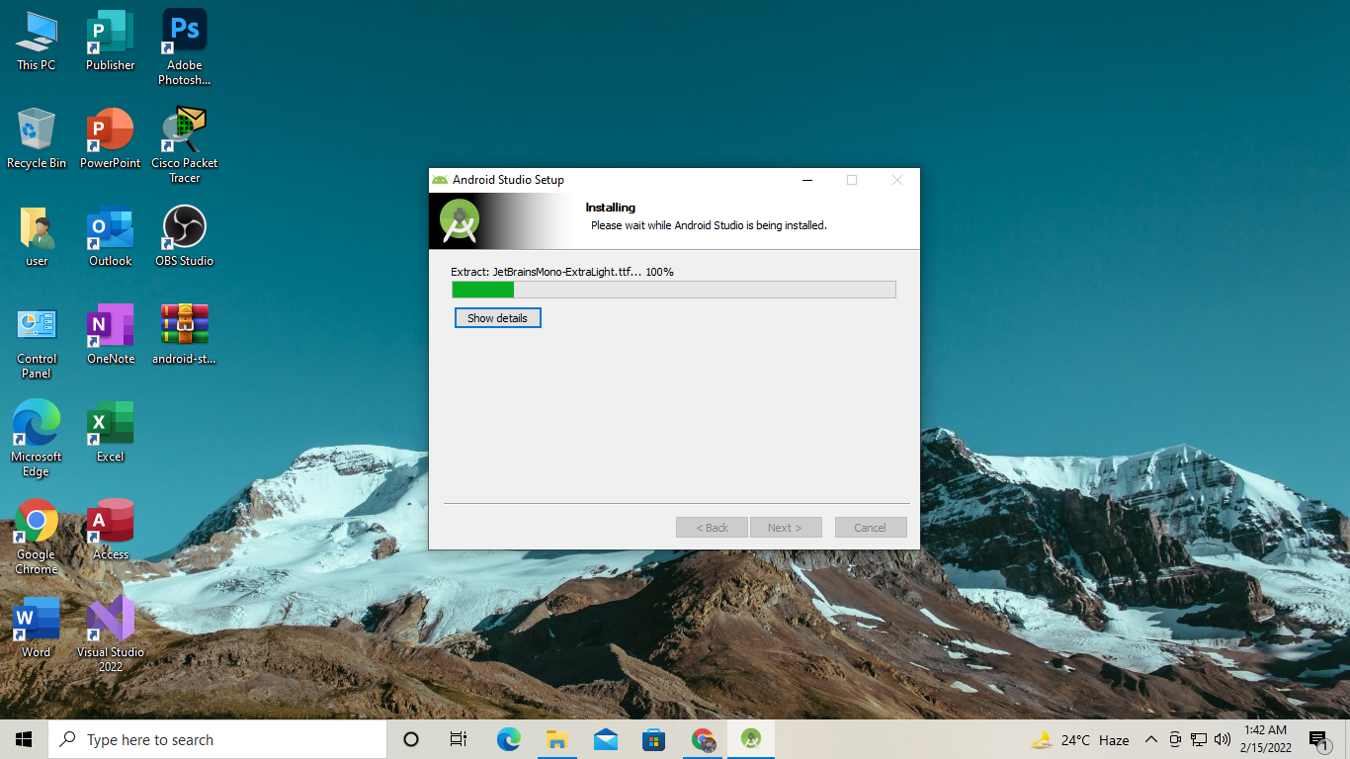
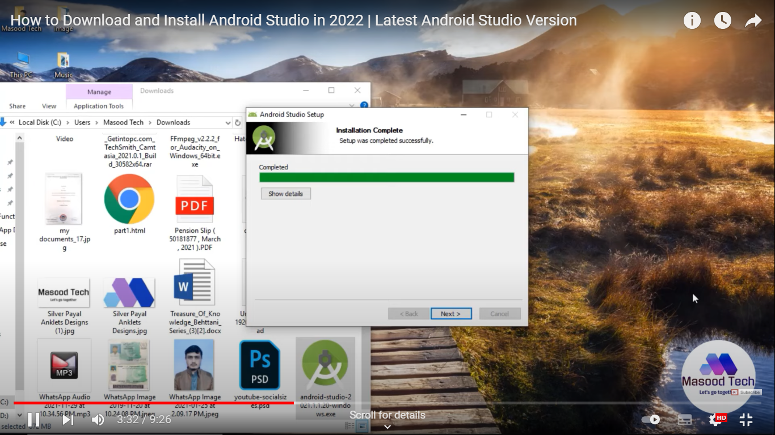
This show the installing process.
This will inform you when it is finished.

Slide 14
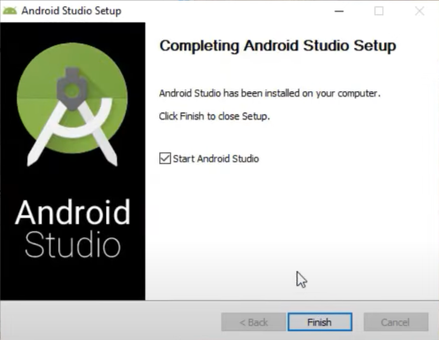
This will inform you that you have completed the installation of the program, and by clicking the "Finish" button, you will continue to the setup.

Slide 15
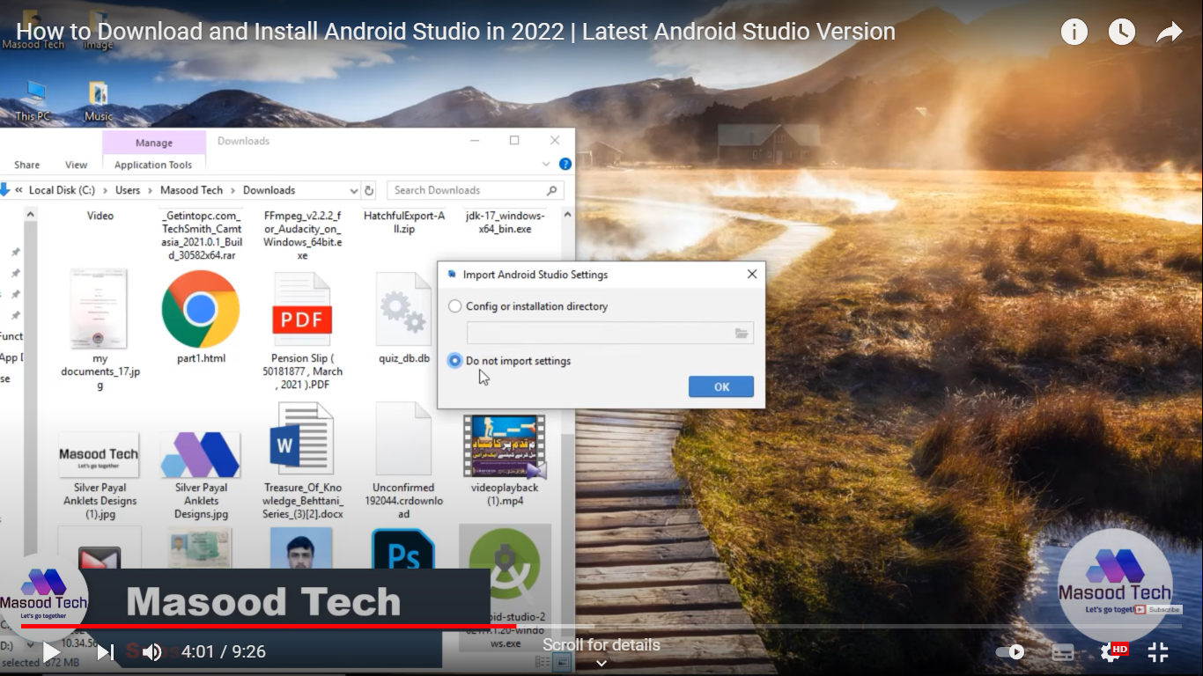
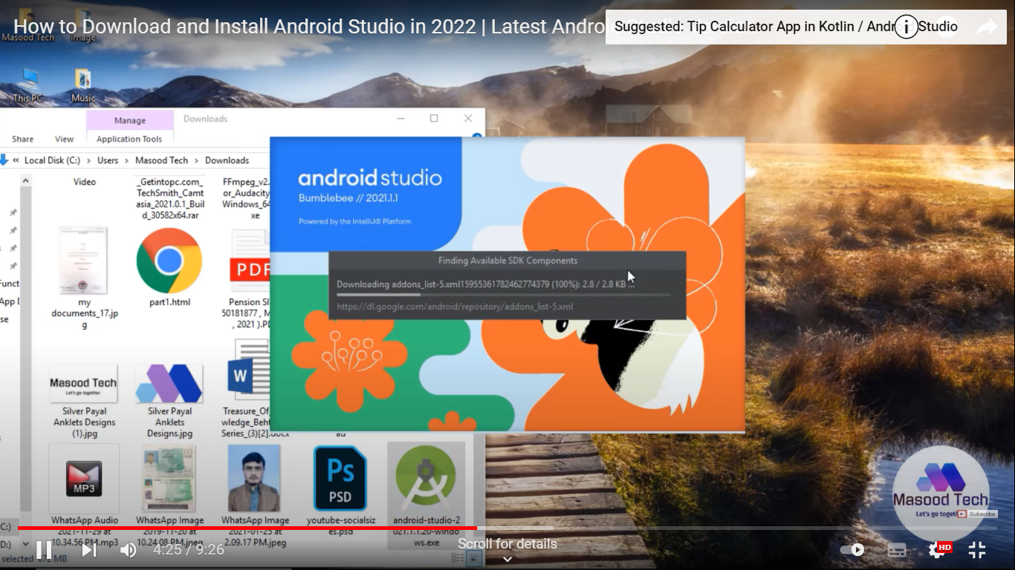
Importing previous version setting.
The previous setting was not imported. Creating a whole new one.
Starting downloading SDK (Software development kit)

Slide 16
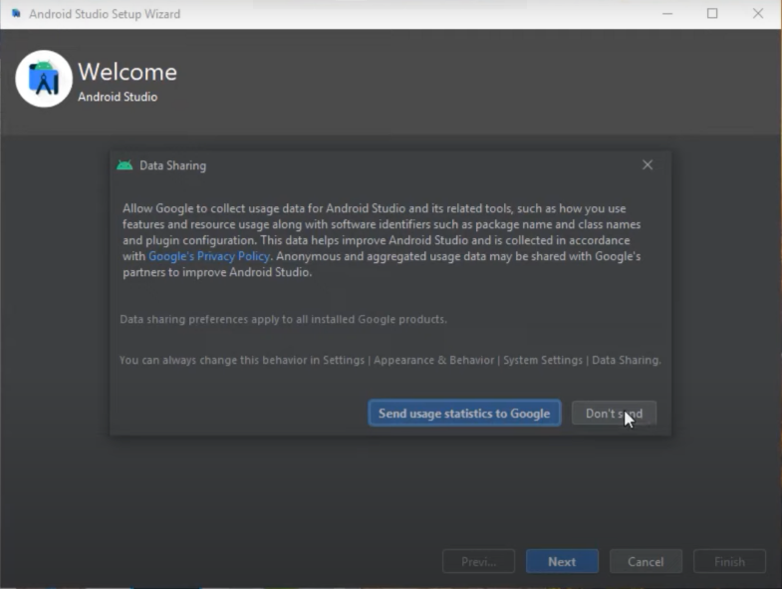
Google usage statistic is a feedback if you like to enable data sharing. You can click don’t send but you can also click send it depends on the user.

Slide 17
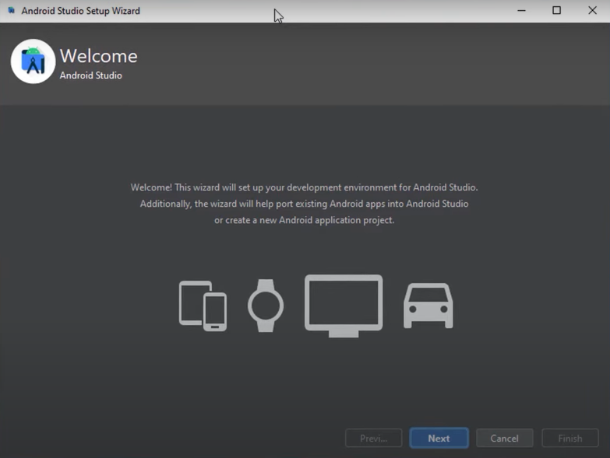
Click next to proceed.

Slide 18
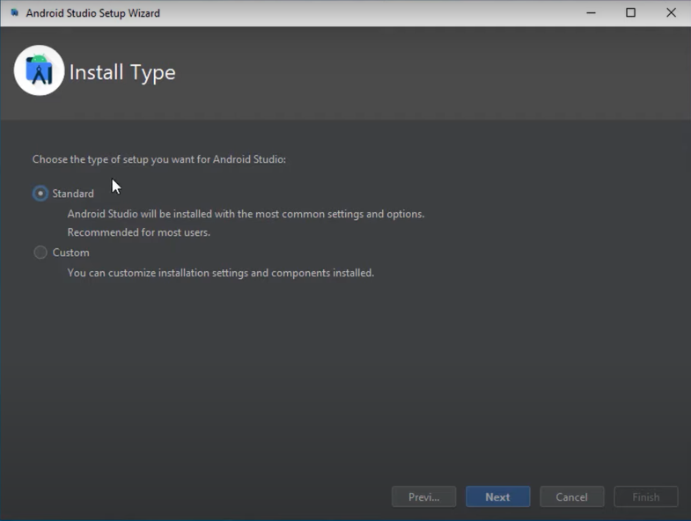
You can click “Standard” & “Custom”. Standard is atomically install all setting and options. Custom is a customization of setting, option, and components to installed.

Slide 19
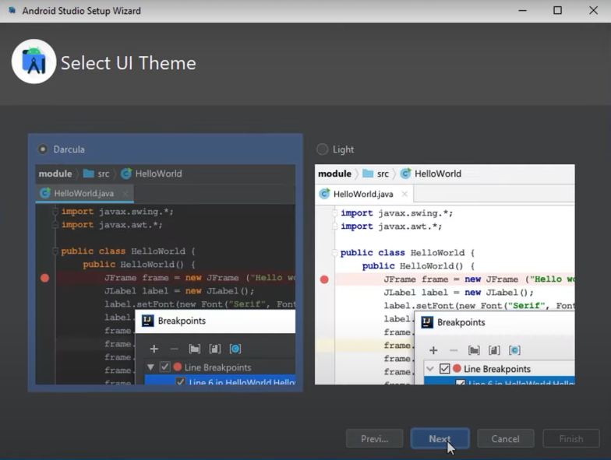
UI (User Interface) Theme. You can choose the theme that you desire.
Click next to proceed.

Slide 20
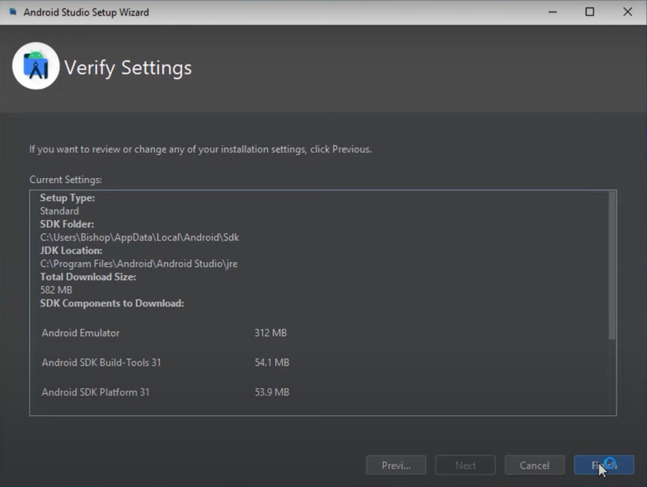
Review of installation setting
Click finish to proceed

Slide 21
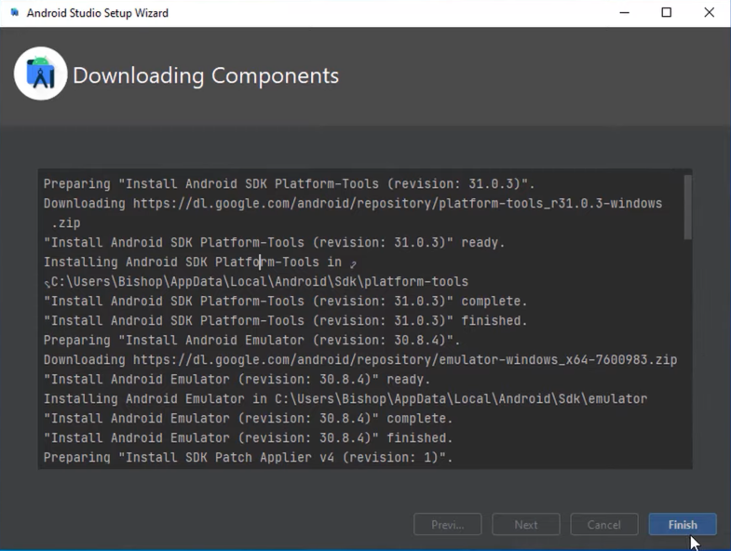
Verifying, Reading and installing components
Click “Finish” to complete installation.

Slide 22
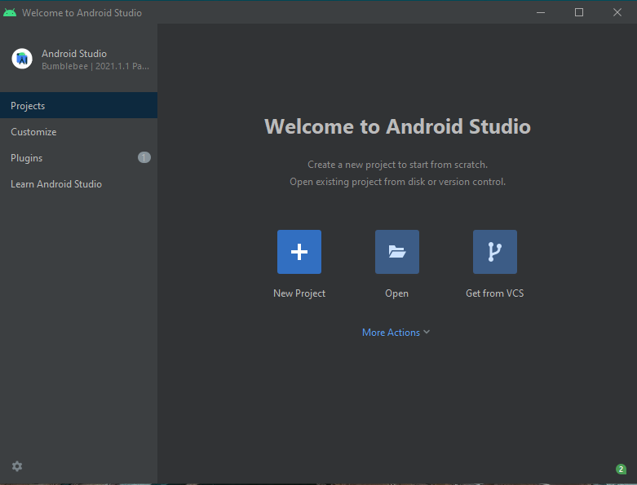
Now you can create your New Project System in your Device.
“Thank you”

